Slide 1
WEBER COUNTY SHERIFF’S OFFICE WEST HAVEN CITY
2013 PROGRESS REPORT

Slide 2
CALL BREAKDOWN
 |  | REPORTS
CALL DESCRIPTION | TOTAL |  | CALL DESCRIPTION | TOTAL
911 calls | 4 |  | Medicals | 10
Abandoned vehicles | 1 |  | Missing persons | 1
Alarms | 9 |  | Neighborhood disputes | 1
Alcohol (Underage) | 4 |  | Ordinance violations | 1
Animal complaints | 24 |  | Premise checks | 6
Assaults | 3 |  | Reckless drivers | 1
Assist other jurisdictions | 2 |  | Registration violation | 1
Burglaries | 3 |  | Runaways | 2
Child abuse/neglect | 4 |  | Sex offenses | 2
Citizen assists | 6 |  | Stolen/recovered vehicles | 0
Civil disputes | 4 |  | Suspicious activity | 20
Community policing | 16 |  | Telephone harassment | 2
Criminal mischief | 3 |  | Thefts | 5
Deaths | 1 |  | Threatened suicides | 3
Disorderly conduct | 1 |  | Threats | 3
Disturbing the peace | 13 |  | Traffic accidents injury | 1
Domestic violence | 8 |  | Traffic accidents property | 13
Drug violations | 2 |  | Traffic hazards | 3
DUIs | 1 |  | Trespassing | 3
Found property | 1 |  | Traffic stops | 58
Frauds | 4 |  | Vehicle burglaries | 2
Intoxication | 1 |  | VIN inspections | 1
Juvenile problems | 1 |  | Warrants | 8
Keep the peace | 7 |  | Weapon offenses | 1
Loud parties | 2 |  | Welfare checks | 5
SEPTEMBER
548 CALLS
Priority 1 - 171
Priority 2 - 79
Priority 3 - 123
Priority 4 - 153
Priority 5 - 0
Priority 6 - 22

Slide 3
CALL BREAKDOWN
 |  | REPORTS
CALL DESCRIPTION | TOTAL |  | CALL DESCRIPTION | TOTAL
911 calls | 5 |  | Lost property | 2
Abandoned vehicles | 2 |  | Loud parties | 3
Alarms | 15 |  | Medicals | 12
Animal complaints | 27 |  | Mental subjects | 1
Assaults | 5 |  | Missing persons | 2
Assist fire department | 2 |  | Motorist assists | 1
Assist other jurisdictions | 3 |  | Premise checks | 10
Burglaries | 3 |  | Protective orders | 1
Citizen assists | 8 |  | Reckless drivers | 1
Child abuse/neglect | 6 |  | Resisting arrest | 1
Civil disputes | 4 |  | Revoked/Susp DL/Reg | 2
Community policing | 16 |  | Runaways | 3
Criminal mischief | 6 |  | Sex offenses | 3
Custody disputes | 1 |  | Stolen/recovered vehicles | 3
Deaths | 2 |  | Suspicious activity | 18
Disorderly conduct | 1 |  | Thefts | 5
Disturbing the peace | 7 |  | Threatened suicides | 3
Domestic violence | 7 |  | Threats | 5
Drug violations | 5 |  | Traffic accidents injury | 3
Extra patrol | 1 |  | Traffic accidents property | 14
Fireworks | 1 |  | Traffic hazards | 2
Found person | 1 |  | Trespassing | 5
Frauds | 2 |  | Traffic stops | 92
Hit & run | 2 |  | Vehicle burglaries | 0
Intoxication | 2 |  | VIN inspections | 1
Juvenile problems | 5 |  | Warrants | 5
Keep the peace | 8 |  | Welfare checks | 8
AUGUST
631 CALLS
Priority 1 - 211
Priority 2 - 89
Priority 3 - 163
Priority 4 - 132
Priority 5 - 0
Priority 6 - 36

Slide 4
Property Crimes Jan-Sept

Slide 5
INVESTIGATIONS
A small percentage of offenders are responsible for a large percentage of crime
Many property crimes are drug-related
Identify criminal groups and individuals
Utilize all available resources
Solve crimes and make arrests
DetectivE
Steve Haney

Slide 6
CALLS FOR SERVICE 5-YEAR COMPARISON
TOTAL CALLS
2013 5396
2012 4943
2011 5284
2010 5272
2009 4930

Slide 7
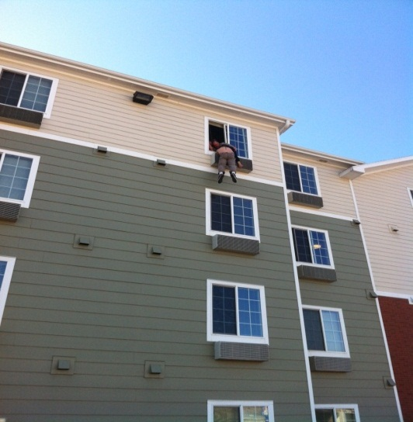
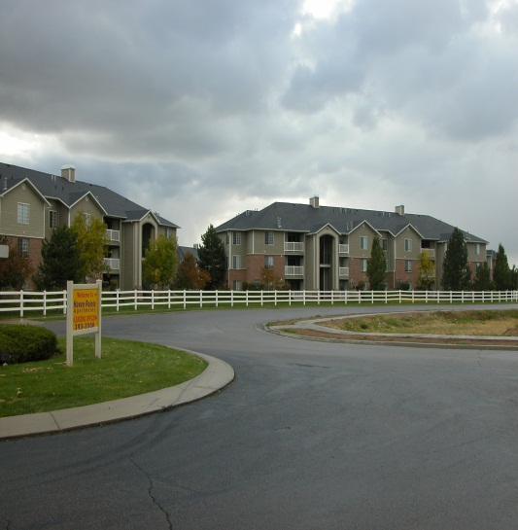
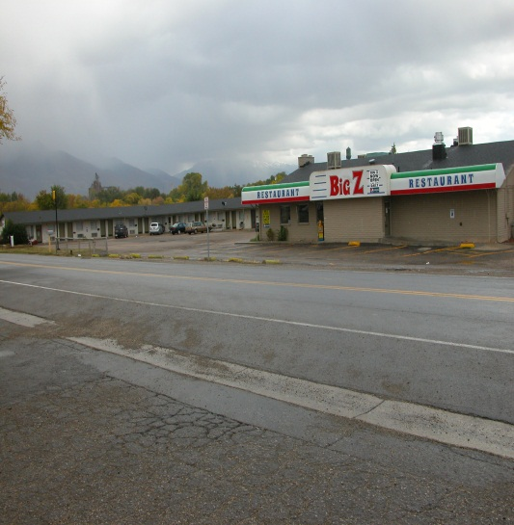
Multiple CALLS = Multiple DEPUTIES

Slide 8
09/14/2013 (Saturday)
12 calls (7 Priority One) utilizing 6 deputies over a 6-hour time period
2108 Welfare Check/domestic violence - 2540 W. 2200 S. (2 deputies)
2126 Fight/loud party/2 arrests - 3330 S. Midland Dr. (3 deputies)
2246 Child neglect/baby not breathing/hospital - 2265 S. 1100 W. (2 deputies)
2321 911 unknown/domestic violence – 2299 S. 1200 W. (2 deputies)
2328 Welfare check/missing person – 2160 S. 1200 W. (2 deputies)
0012 Noise disturbance/loud music – 3519 S. 2700 W. (2 deputies)
0022 Fight/assault/Los Rocas/1 arrest - 3050 S. Scott Ln. (2 deputies)
0046 Criminal mischief/house egged – 2686 S. 3300 W. (1 deputy)
0051 Welfare check/suicidal subject – 2160 S. 1200 W. (2 deputies)
0136 Loud Party/disturbance – 2265 S. 1100 W. (2 deputies)
0148 Reckless driver/road rage – 1900 W. 1800 S. (1 deputy)
0247 Overdose/Death – 1123 W. Wilson Ln. (2 deputies)

Slide 9
CITATIONS

Slide 10
CITATIONS 5-YEAR COMPARISON

Slide 11
Arrests 5-year Comparison
ARRESTS
2013 173
2012 123
2011 124
2010 151
2009 117

Slide 12
100+ ARRESTS in 2013
DEPUTY MARK WIAN

Slide 13
DV AND ASSAULTS

Slide 14
SEX AND DRUGS

Slide 15
PROPERTY CRIMES

Slide 16
IMPACT OF ARRESTS ON CRIME

Slide 17
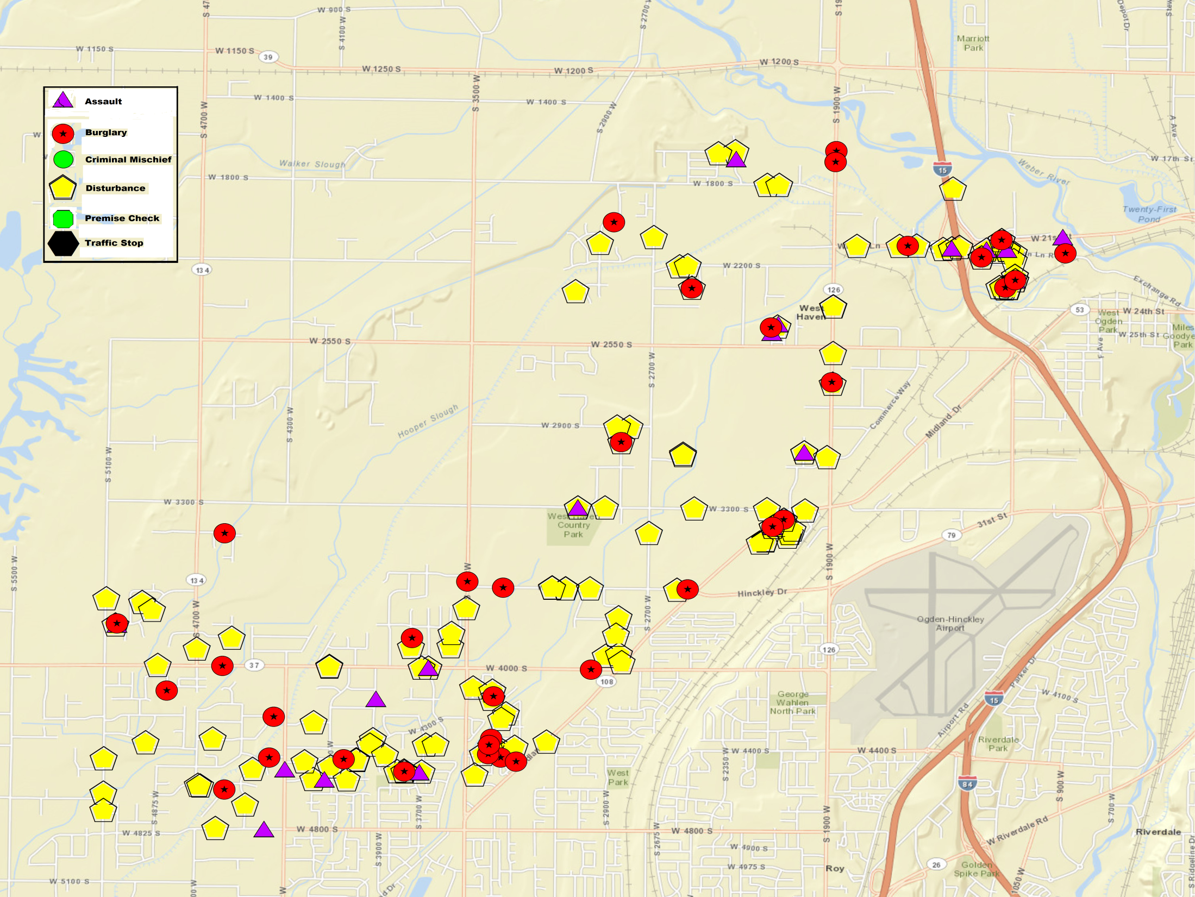

Slide 18
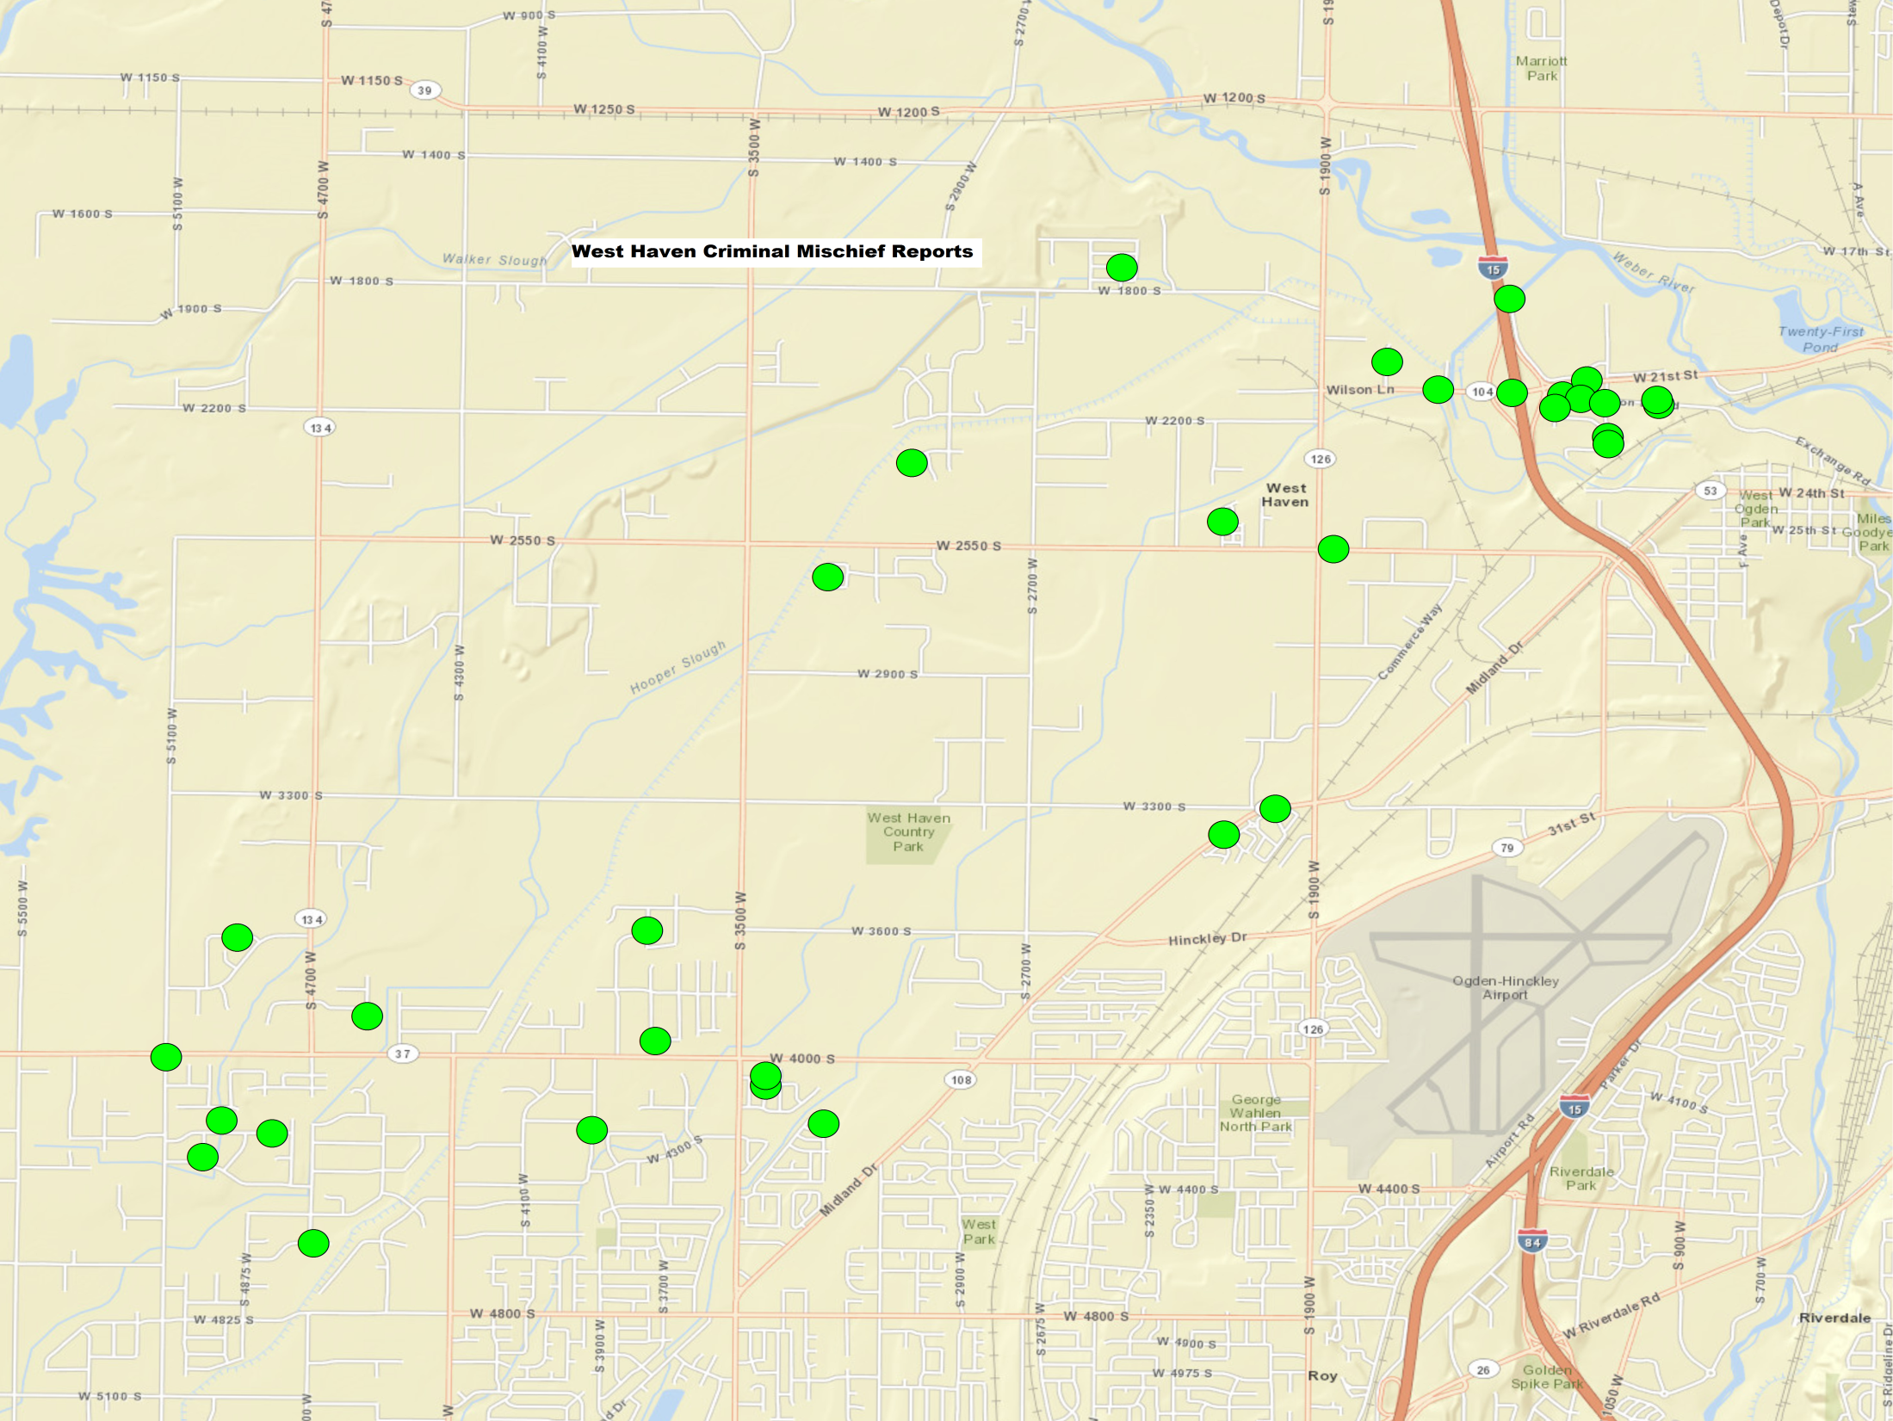

Slide 19
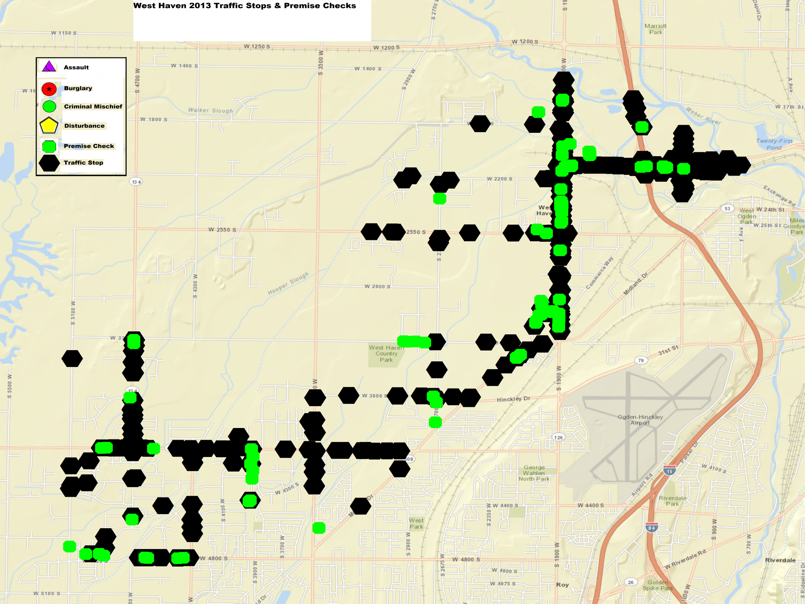

Slide 20
CRIME PATTERNS AND STRATEGIES
Overall, call volume has increased during the first eight months of 2013. This is not due to an increase in crime but rather an increase in community-oriented policing efforts which include school visits and business checks.
Overall, violent crime and property crime rates remain relatively low. After an increase in property crimes the first part of the year, the numbers have declined significantly. This is credited to identifying and arresting specific criminals groups who are responsible for a large percentage of the crimes.
The deputies assigned to West Haven this year have been extremely pro-active and aggressive in their efforts to protect the city. This has resulted in a record number of arrests and a reduction in crime.
Problems areas continue to be along 21st Street and 1900 West.
The Mongols “clubhouse” on Exchange is of particular concern.

Slide 21
MONGOLS Motorcycle GANG RIDES INTO WEST HAVEN
880 W. WILSON LANE
Drug Trafficking Violence Organized Crime

Slide 22
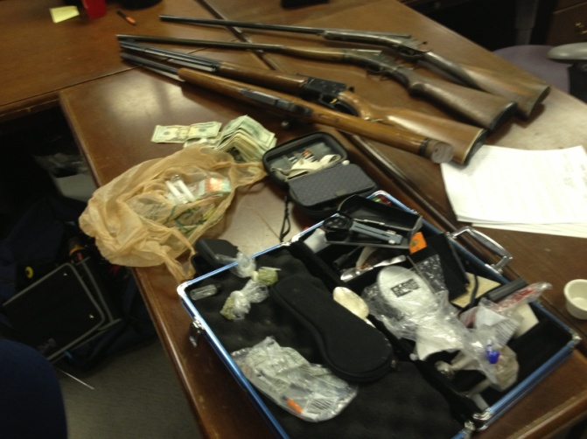
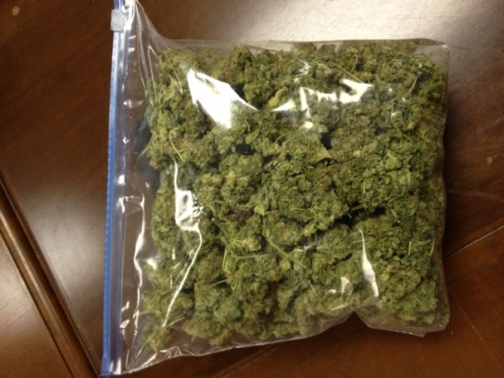
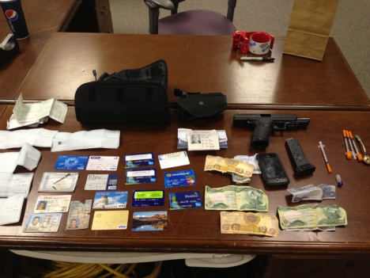
DRUGS
2012
39 Strike Force cases
28 arrests

Slide 23
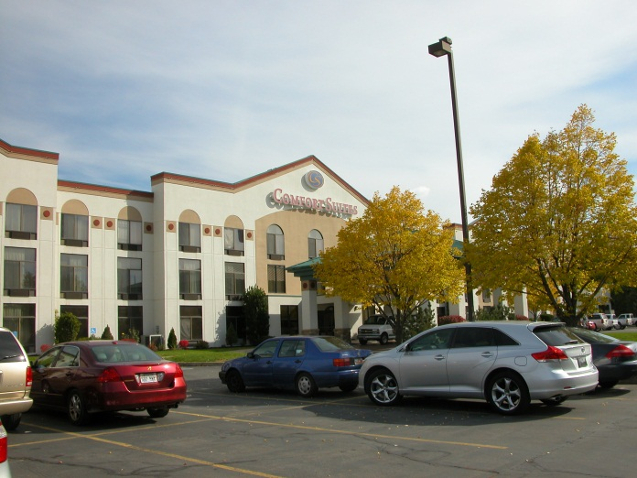
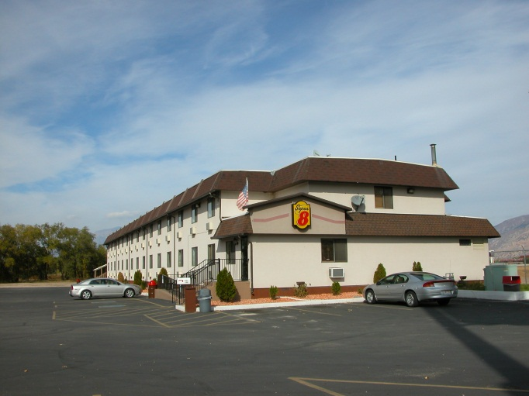
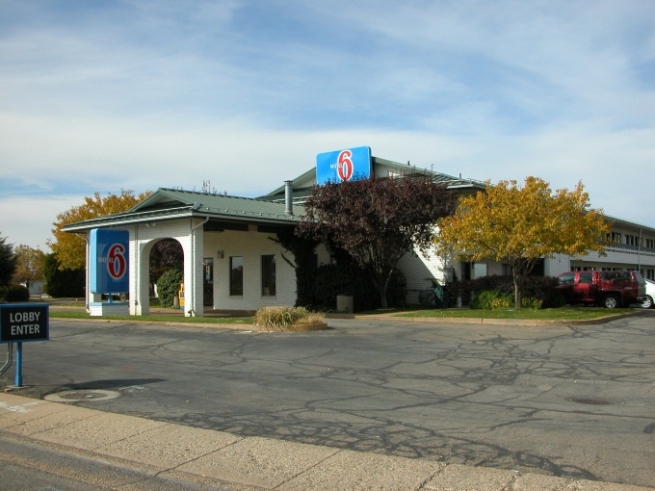
INTERDICTION

Slide 24
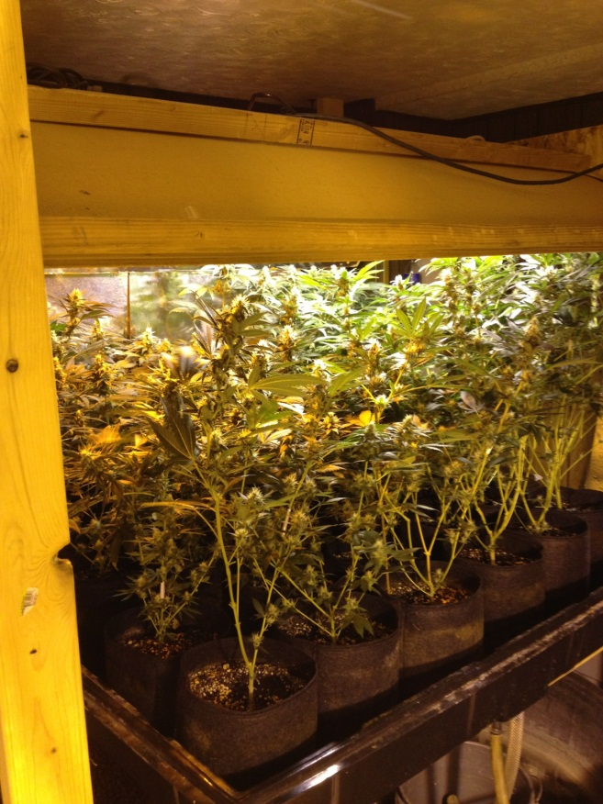
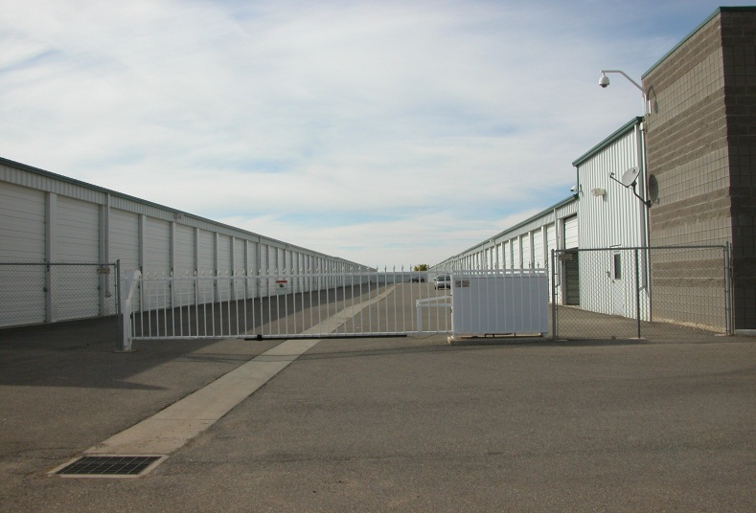
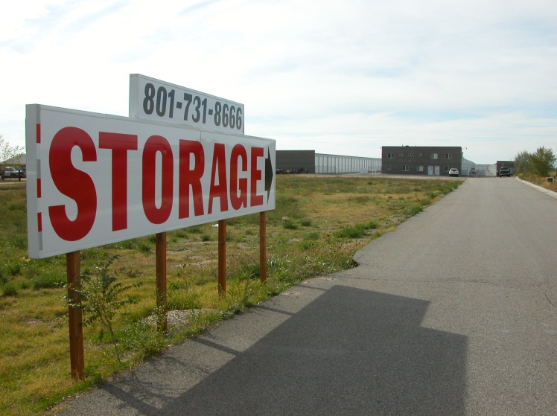
RECENT TRENDS
1-866-TIP-A-COP

Slide 25
OH SNAP!

Slide 26
PREMISES CHECKS
Jan-SEPT 2013
192
Jan-SEPT 2012
57

Slide 27
Together we can reach new heights!

Slide 28
SCHOOL VISITS
West Haven Elementary
43
Country View
32
Rocky Mountain
16
QUEST
73
KanesVille
69

Slide 29
QUESTIONS?

